Slide 1
Synergy! A world where the tools communicate
Joshua “Jabra” Abraham
Rapid7 LLC
jabra@spl0it.org
jabra@rapid7.com
Fall 2009

Slide 2
Purpose of this talk
Raising the bar on pentesting
  Build upon current tools
  Leverage XML to automate pentesting tasks
  Extract data for a correlation engine
What we are doing today
  High-level overview of an improved process (COE)
  Releasing several modules

Slide 3
Encourage developers to
build tools with XML and APIs

Slide 4
Agenda (Intense 25 minutes)
Programming focused talk
A boat load of XML and parsers
Automating the “stupid” stuff…
  Several new modules

Slide 5
Flow is Key
Tools
Database
Human
UNIX tools
  Program
  Shell script
Data processing
  txt => manual
Recon
Vulnerability Scan
Port Scan
Database

Slide 6
Add the Manual Aspect
Computers are good at doing specific tasks
  Identifying Open Ports, Finding XSS and Bruteforcing passwords
Humans are good at doing non-specific task
  Reasoning based on context
Database
Recon
Vulnerability Scan
Port Scan
Manual Testing

Slide 7
Level the playing field
All components are equal. However, some components are more equal than others.
We will focus on automated testing
Vulnerability Scan
Automated Testing
Manual Testing
Central Storage Engine
Recon
Correlation
Reporting
View/Modify/Delete Data
Context Based
Focus Driven
Goal Oriented
Port Scan

Slide 8
Techniques
Nikto::Parser
Active Testing
Sslscan
Sslscan::Parser
Port Scanning
Nmap::Parser
-
Net::Hostname
Recon
Nikto
Fierce
Fierce::Parser
Nmap
Dirbuster
Dirbuster::Parser
Passive Testing
Vulnerability Scanning

Slide 9
Programming Language
Sounds like Earl, but starts with a “P”
The programming language is Perl
  The following are NOT programming languages:
    PERL, perl, Pearl
Cross Platform
Built for Scripting and Object Orientation
Libraries = modules
  Load a module: use My::Module;
Docs
  perldoc perl
  perldoc My::Module

Slide 10
Setup Phase
The rest of the talk will be all code!
Loading the following modules:
  use Nikto::Parser;
  use Dirbuster::Parser;
  use Sslscan::Parser;
  use Fierce::Parser;
  use Net::Hostname;

Slide 11
Setup Phase
Creating parser objects:
  my $np = new Nikto::Parser;
  my $dp = new Dirbuster::Parser;
  my $sp = new Sslscan::Parser;
  my $fp = new Fierce::Parser;

Slide 12
Net::Hostname
Resolves Hostnames for IPv4 and IPv6
my $h = Net::Hostname->new(hostname => “www.google.com”);
print $h->resolveIPv4 . “\n”;
#64.233.169.104
print $h->resolveIPv6 . “\n”;
#2001:4860:b002::68

Slide 13
Fierce (Network Reconnaissance tool)
Built to find IPs owned by your target
  Version 1.0 built by Rsnake
  Version 2.0 re-written by Jabra
Techniques
  Enumerate DNS servers and check for Zone Transfer
  Enumerate prefixes, extensions and subdomains
  Virtual Host detection
  Check for MX records and Wildcards
  Reverse Lookups based on Hostnames
  Range enumeration based on subnet
  ARIN, ARPNIC, etc enumeration….

Slide 14
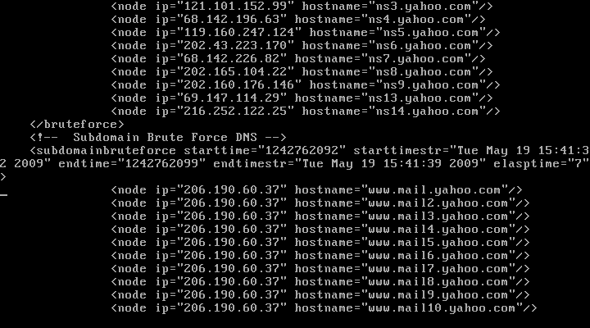
Fierce (Network Reconnaissance tool)

Slide 15
Fierce::Parser
Fierce has many output formats
  TXT, HTML and XML
Parse Data from Fierce XML

Slide 16
Fierce::Parser
my $parser = $np->parse_file(‘google.xml’);
my $node = $np->get_node(‘google.com’);
my $bf = $node->bruteforce;
print “Prefix Bruteforce:\n”;
foreach my $n ( $bf->nodes ) {
print “Hostname:\t” . $n->hostname . “\n”;
print “IP:\t\t” . $n->ip . “\n”;
}

Slide 17
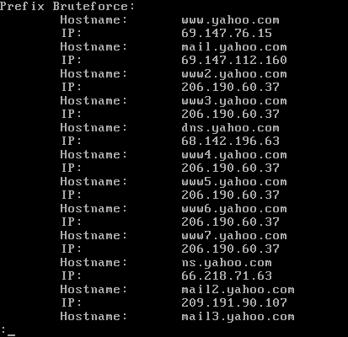
Fierce::Parser

Slide 18
Dirbuster
Web Application Traversing
Identifying locations that do not require authorization
Runs on Linux, Windows and BSD
OWASP project!
New version has XML Output!

Slide 19
Dirbuster::Parser
my $parser = $dp->parse_file(‘dirbuster.xml’);
my @results = $parser->get_all_results();
print “Directories:\n”;
foreach(@results) {
print “Path“ . $_->path . “\n”;
print “Type“ . $_->type . “\n”;
print “Response “ . $_->response_code . “\n”;
}

Slide 20
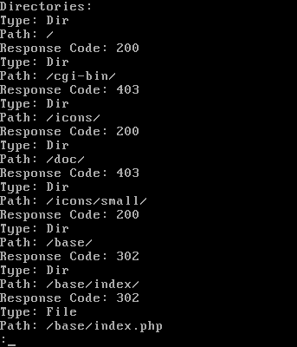
Dirbuster::Parser

Slide 21
Encourage developers to
build tools with XML and APIs

Slide 22
Sslscan
SSL Cipher testing
Similar to SSLDigger
Sslscan runs on Linux, Windows and BSD
XML Output
Supports both HTTPS and SMTP

Slide 23
Sslscan::Parser
my $parser = $sp->parse_file(‘domain.xml’);
my $host = $parser->get_host(‘domain.com’);
my $port = $host->get_port(‘443’);
foreach my $i ( grep($_->status =~ /accepted/, @{ $port->ciphers }) ) {
print “sslversion “ . $i->sslversion . “\n”;
print “cipher “ . $i->cipher . “\n”;
print “bits “ . $i->bits . “\n”;
}

Slide 24
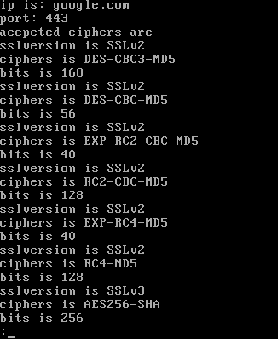
Sslscan::Parser

Slide 25
Nikto::Parser
Options for usage:
  Scan and save XML for parsing later.
  Scan and parse XML inline

Slide 26
Nikto::Parser
my $parser = $np->parse_file(‘nikto.xml’);
my $h = $parser->get_host(‘127.0.0.1’);
my $p = $h->get_port(’80’);
print “Target is: “ . $h->ip . “:” . $p->port . “\n”;
print “Banner is: “ . $p->banner . “\n\n”;
foreach my $v ( @{ $p->get_all_items(); } ) {
print $v->description . “\n\n”;
}

Slide 27
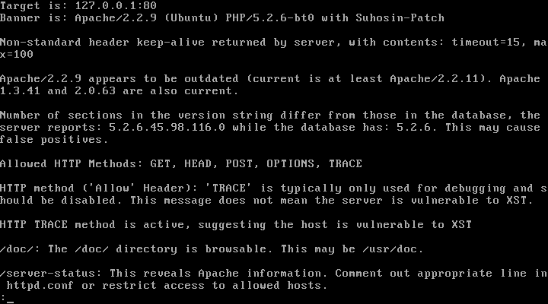
Nikto::Parser

Slide 28
Results
Nikto::Parser – parse Nikto data
Sslscan::Parser – parse Sslscan data
Fierce::Parser – parse Fierce data
Dirbuster::Parser – parse Dirbuster data
Net::Hostname – resolve hostnames
All code will be available at:
http://spl0it.org

Slide 29
Summary
Extracting Data for the Central Storage Engine…
Many tools, we have the choice how
  Shell scripts, XML Parsers or manually
Vulnerability Scan
Automated Testing
Manual Testing
Central Storage Engine
Port Scan
Recon
Correlation
Reporting
View/Modify/Delete Data
Context Based
Focus Driven

Slide 30
Encourage developers to
build tools with XML and APIs

Slide 31
Contact Information
Joshua “Jabra” Abraham
  jabra@spl0it.org
  jabra@rapid7.com
  http://spl0it.wordpress.com
  http://spl0it.org/files/talks/appsec09
  (Final version of the slides, demos and code)

